Slide 1

Final Project
TEAM NAME: Anthony Fadly and Sami Shami

Slide 2
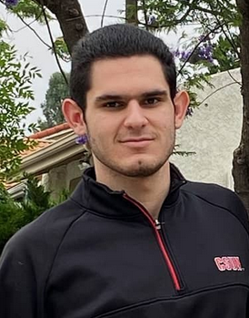

Introduction
I am Sami Shami
Computer Science Major with a minor in Mathematics. Fall 2022
Enjoy a good challenge that can be solved with programming
I was responsible for the graphic design
Anthony Fadly
CIT Major, philosophy minor
Master of Challanges @ Layer8
Logic design

Slide 3
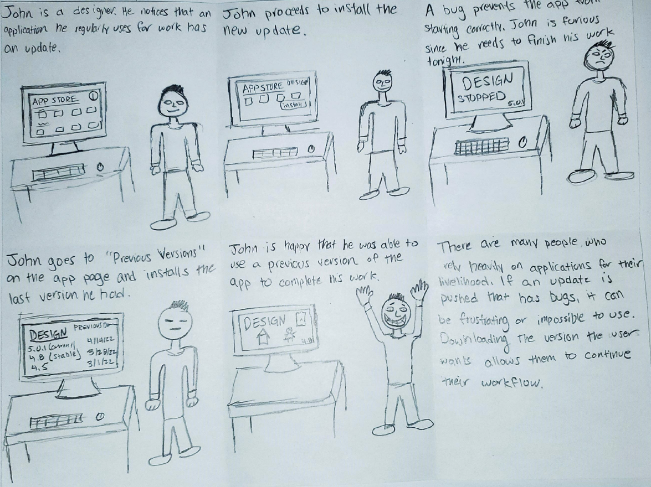
What is Apptatus?

Slide 4
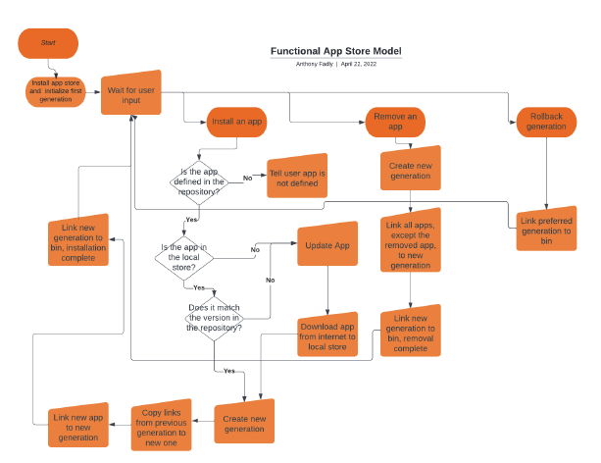
Design Approach
Our goal was to design an app store with features no other app store had
Originally we didn’t want it to look very distinct from other app stores, just to have different logic

Slide 5
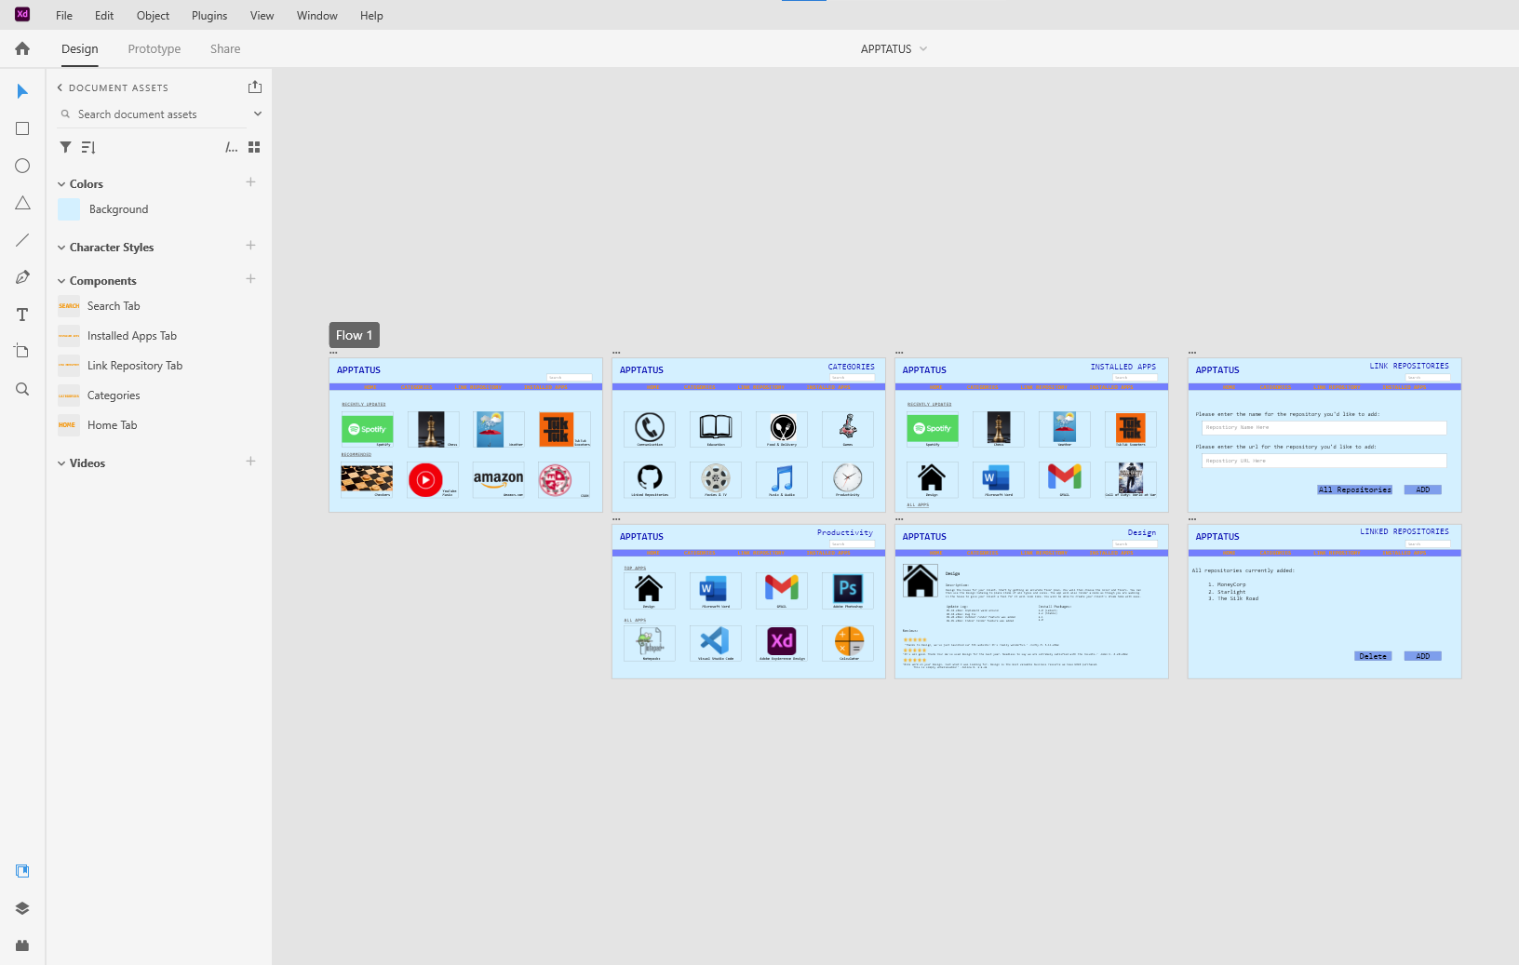
Assets Used
List and describe the assets that have been used for the completion of the project. (xd, paper, pencil, brain)
Adobe XD for designing the final product
Canva for making all the boards (mood board, palette, etc.)
Lucid Charts for creating all the charts and tree diagrams
This is a computer application. It is intended to be used for functionality. It is essentially a web application.

Slide 6
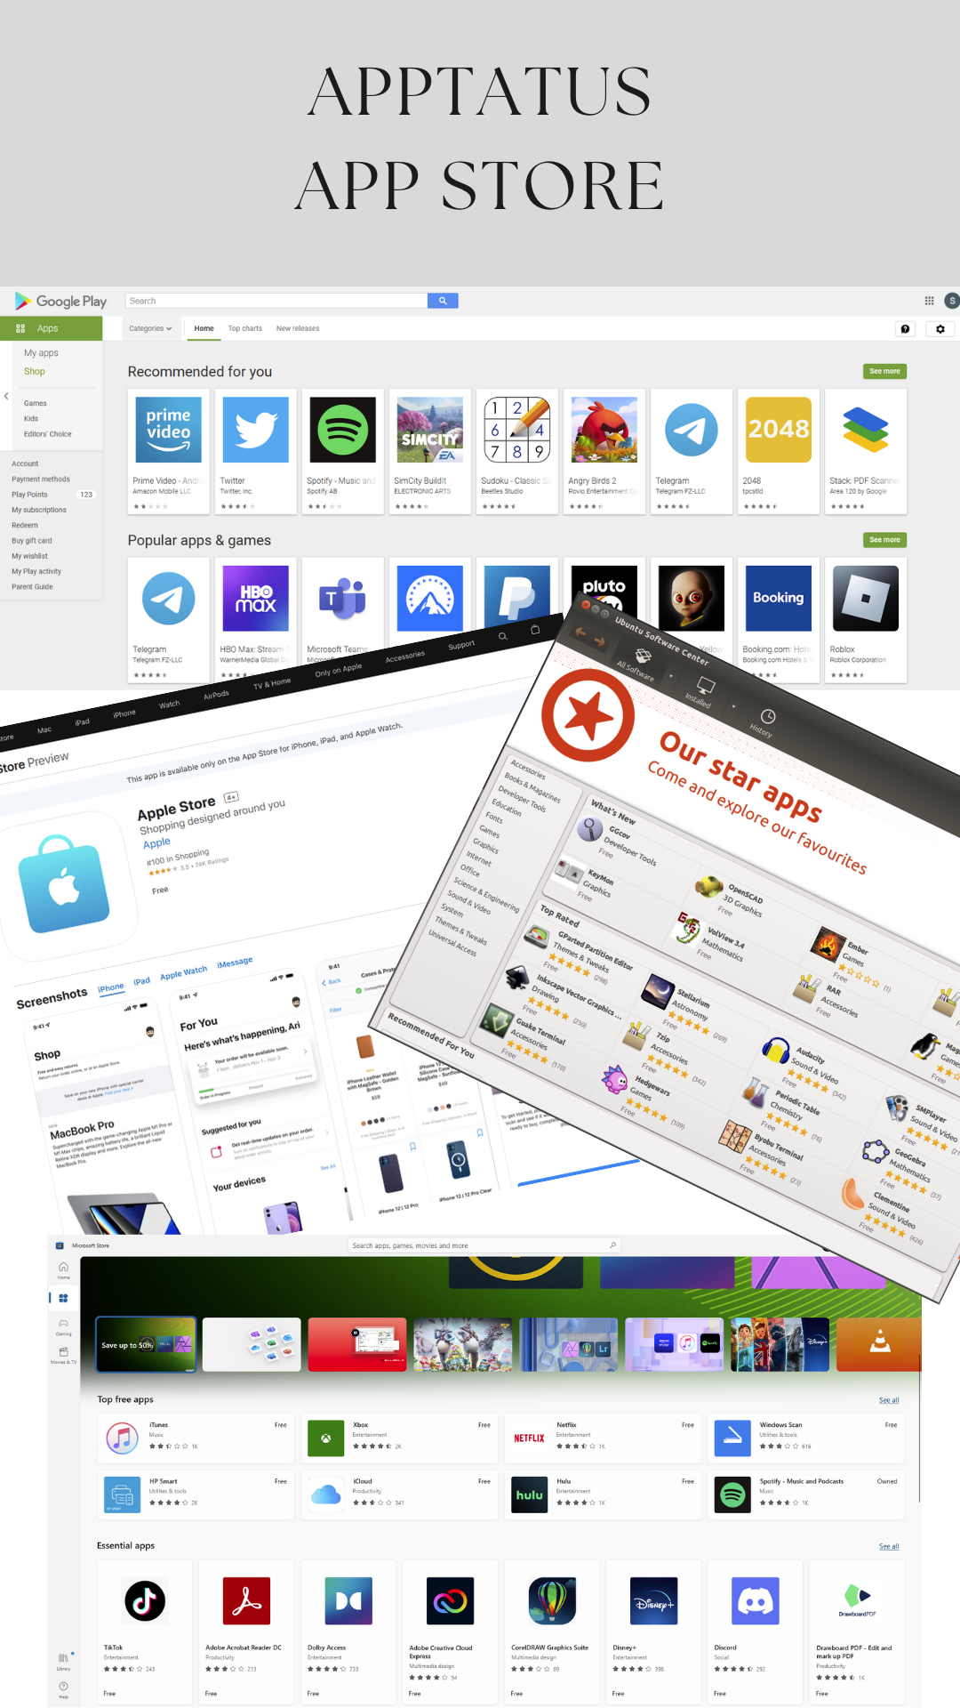
Design Approach
Apptatus is designed for the user. It gives the user freedom through repositories to get apps from many sources
Apptatus is similar to most app stores that you are accustomed to using. It is supposed to be something that is easy to use for any user

Slide 7
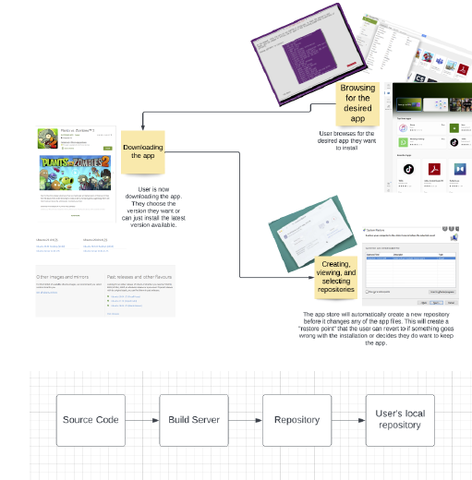
Design Approach
We thought a lot about how Apptatus would manage data both locally and in infrastructure
This consists of the pipeline:
Developers
Continuous Integration Services (CI)
Repositories
Clients
Developers write the source code which gets sent to CI where it’s compiled into build artifacts which are hosted by repositories and finally downloaded by end clients

Slide 8
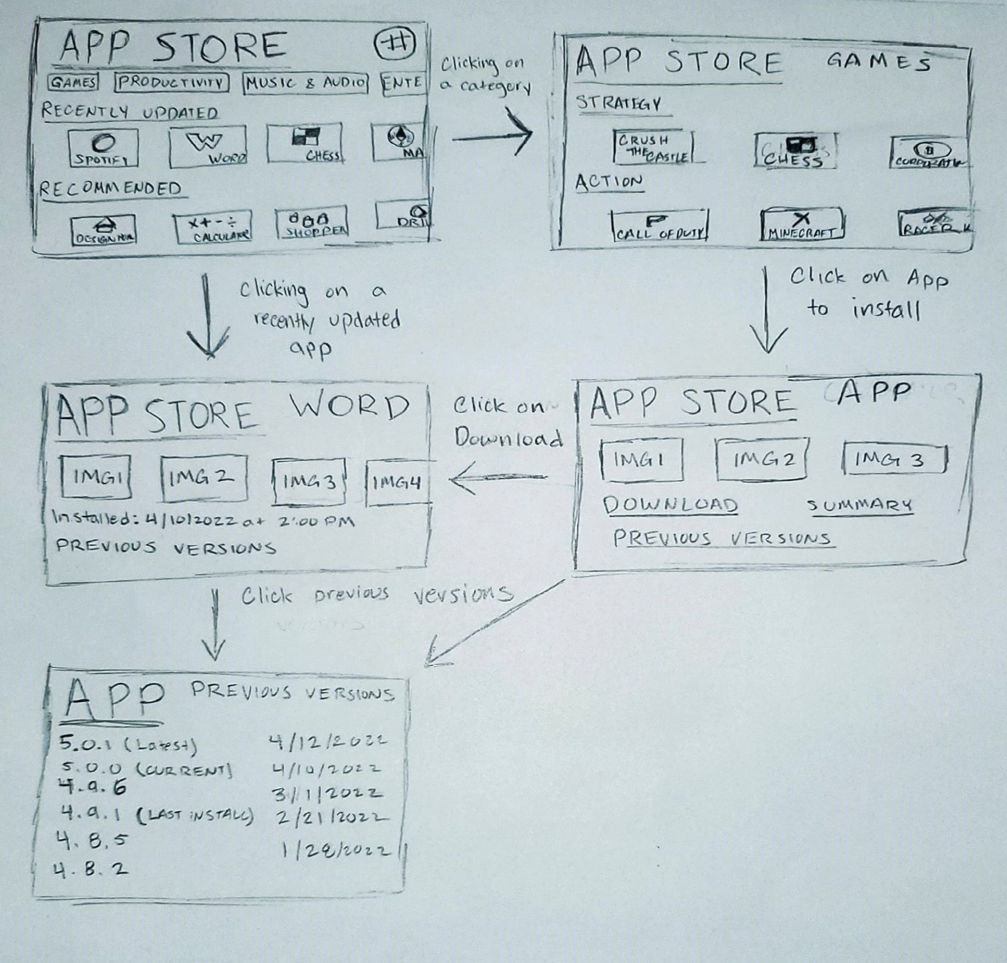
Design Approach
Created a wireframe to see how different pages would interact
We used Adobe XD to create the final model of Apptatus

Slide 9

Demo of Application (EXE)

Slide 10
Design Approach - Challenges
One challenge we faced was deciding on the visual style of Appstatus
It needed to be similar enough to existing app stores to feel familiar to users but it also needed to stand out
We overcame this challenge be creating a design that emphasized the features that are unique to Appstatus

